Slide 1

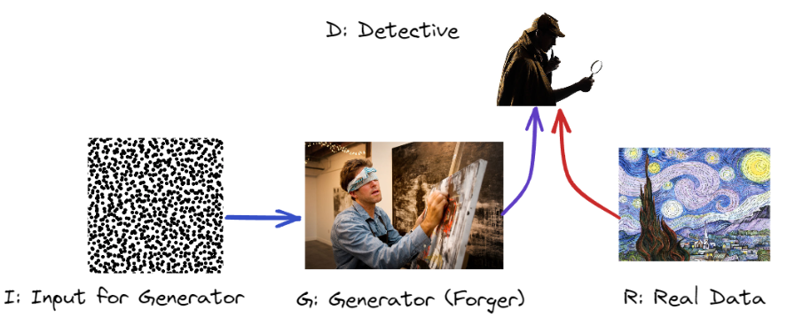
Introduction to
Generative Adversarial Networks
GANS
https://f21dl.github.io/workshop/gans/
Thursday 19th October (Week 6) in LT1 at 9-10am and EM245 and EM252 10am-5pm.
Benjamin Kenwright
Data Mining and Machine Learning
b.kenwright@hw.ac.uk

Slide 2
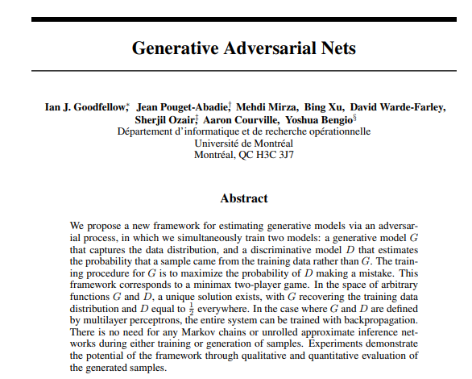
Introduction
Generative adversarial networks (GANs) were proposed in 2014 paper [1]
[1] Goodfellow, I., Pouget-Abadie, J., Mirza, M., Xu, B., Warde-Farley, D., Ozair, S., Courville, A. and Bengio, Y., 2014. Generative adversarial nets. Advances in neural information processing systems, 27.

Slide 3
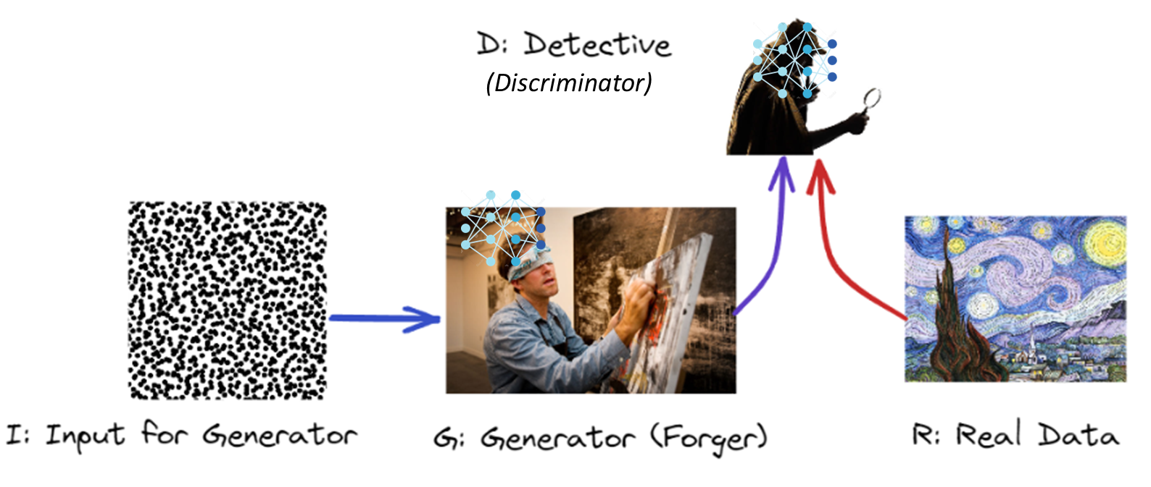
Introduction
Generative adversarial networks (GANs) were proposed in 2014 paper [1]
A GAN is composed of two neural networks (Generator and Discriminator)
Generator: Takes a random distribution as input (typically Gaussian) and outputs some data (e.g., image). You can think of the random inputs as the latent representations (i.e., codings) of the image to be generated
Discriminator: Takes either a fake image from the generator or a real image from the training set as input, and must decide if the input image is fake or real
[1] Goodfellow, I., Pouget-Abadie, J., Mirza, M., Xu, B., Warde-Farley, D., Ozair, S., Courville, A. and Bengio, Y., 2014. Generative adversarial nets. Advances in neural information processing systems, 27.

Slide 4
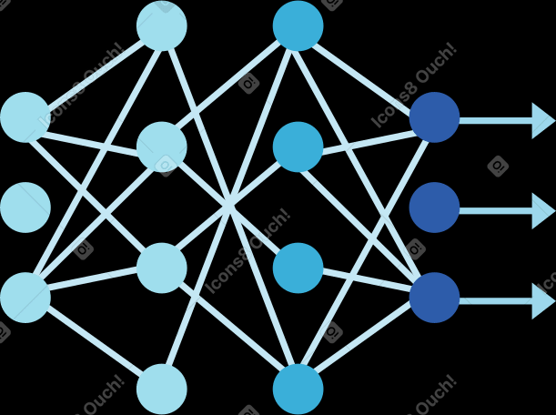
Overview
(Discriminator)
Key Components

Slide 5

GAN Applications
What can we use GANs for?

Slide 6
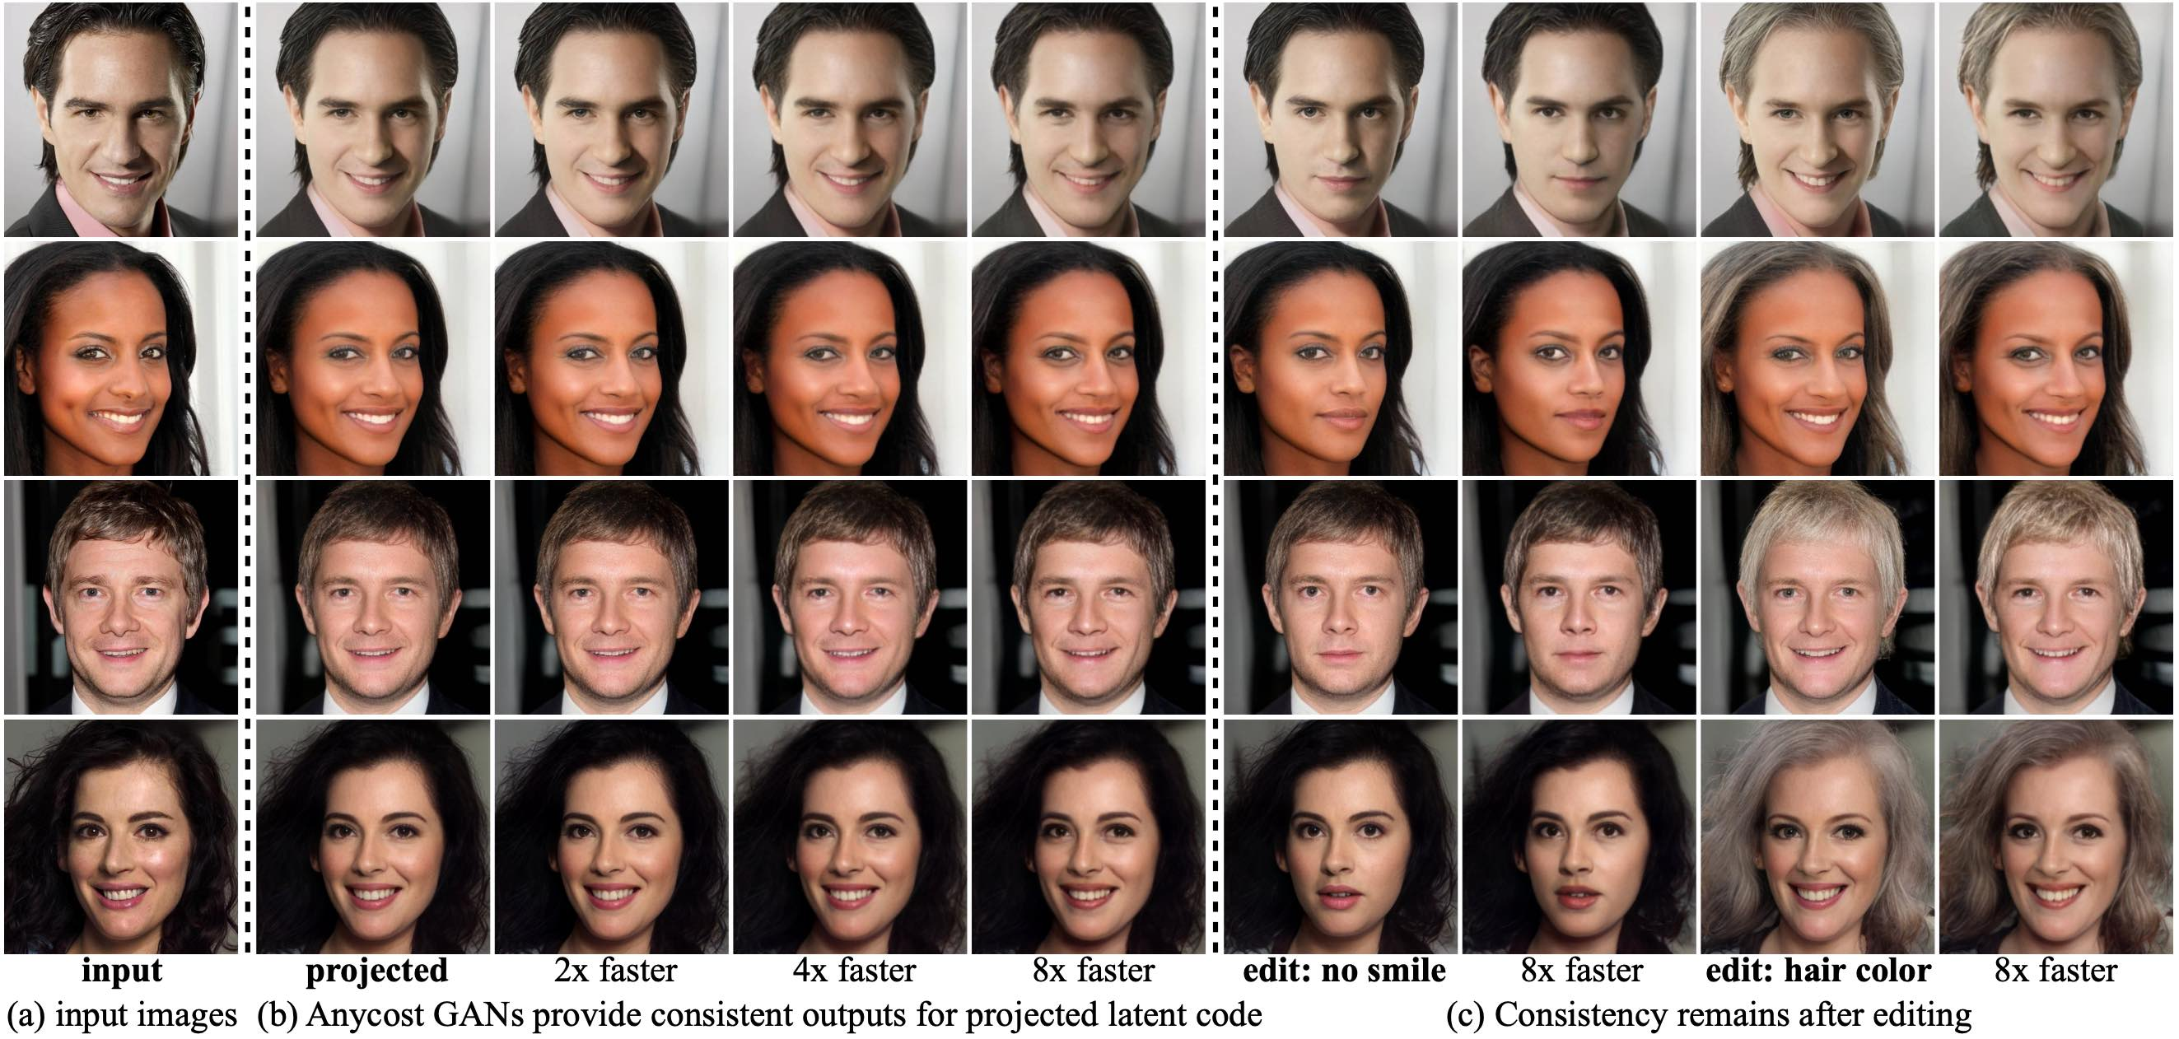
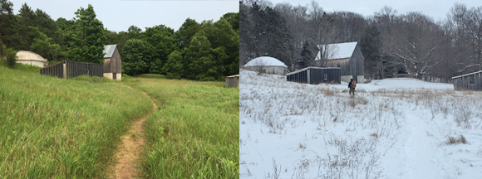
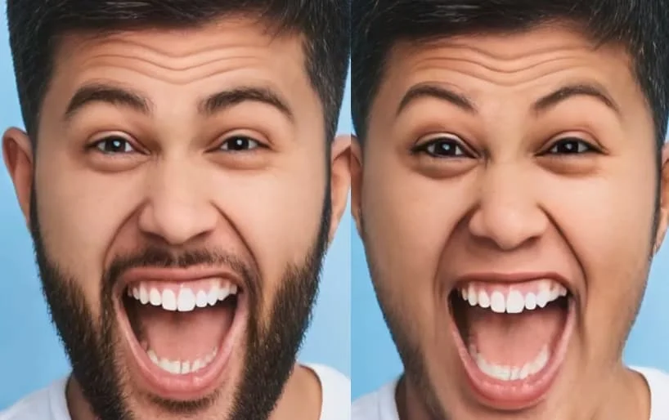
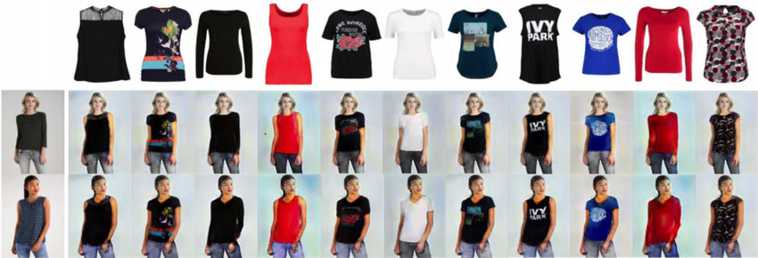
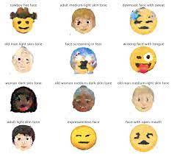
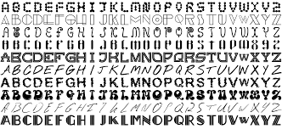
GAN Applications
What can we use GANs for?
Generate photographs of human faces
Generate realistic photographs
Generate cartoon characters
Generate examples for image datasets
Image-to-image translation
Text-to-image translation
Semantic-image-to-photo translation
Face frontal view generation
Generate new human poses
Face aging
Photograph editing
Photos to emojis
Photo blending
Super resolution
Clothing translation
Photo inpainting
3D object generation
Video prediction
Small set of examples…

Slide 7
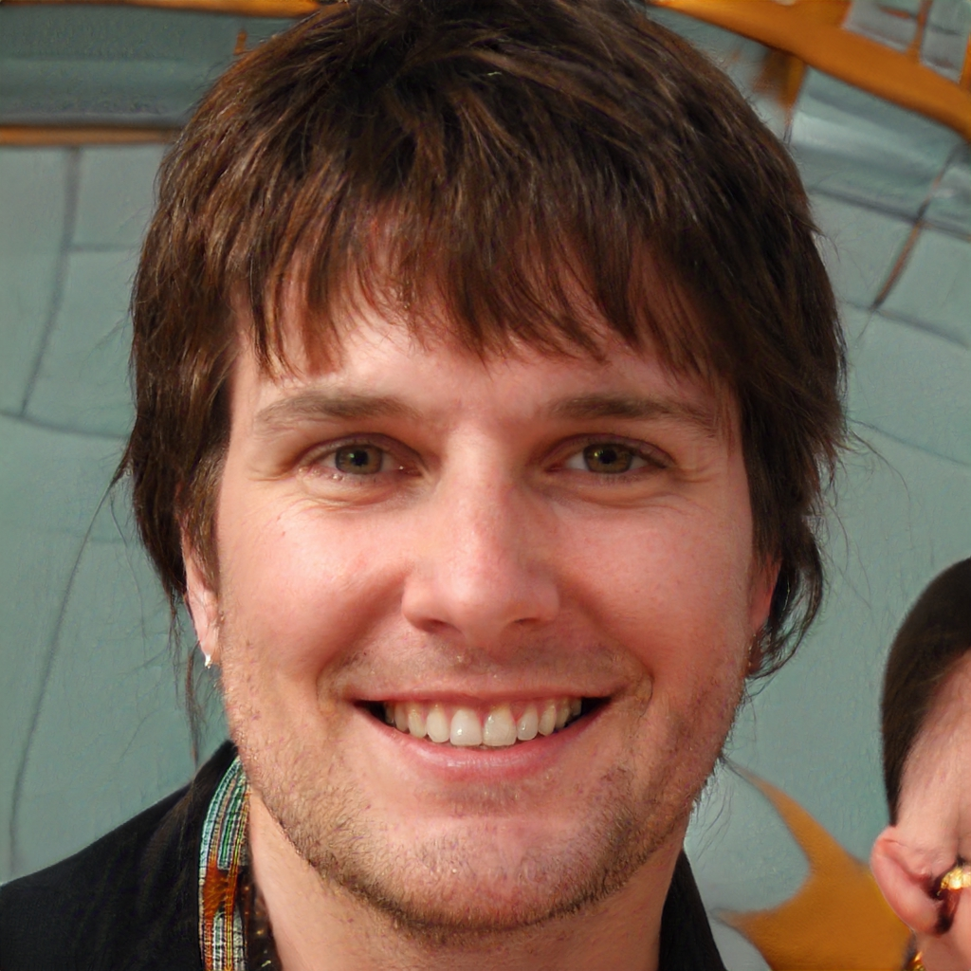
Example GAN
https://thispersondoesnotexist.com/
“thispersondoesnotexist.com” is a website which uses an AI GAN model to generate new faces every-time you refresh the page

Slide 8
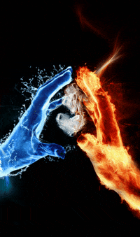
GAN Training
The generator and discriminator have opposite goals
Discriminator tries to tell fake images from real images
Generator tries to produce images that look real enough to trick the discriminator
GAN is composed of two networks with different objectives, it cannot be trained like a regular neural network.
Each training iteration is divided into two phases

Slide 9

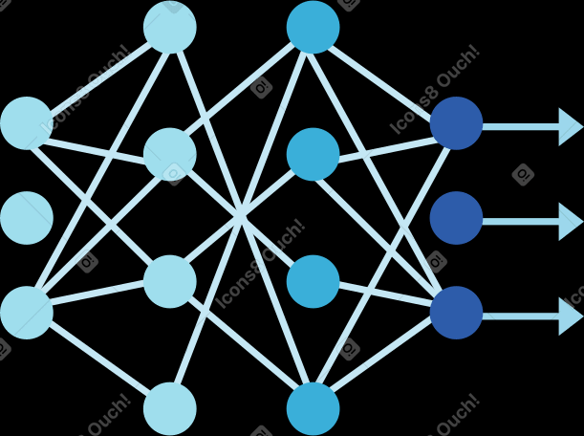
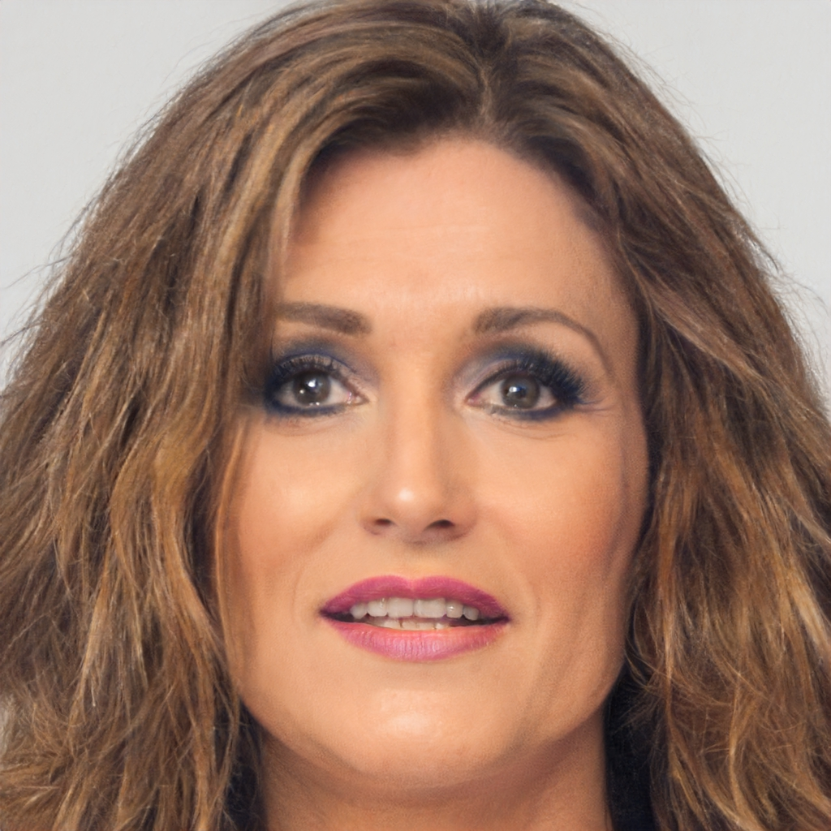
Discriminator
Training Phases
1
Gradient
D Loss
D
Real
Real
Loss
Fake
Noise (z)
G
G Loss
Fake
2
Gradient
Generator

Slide 10
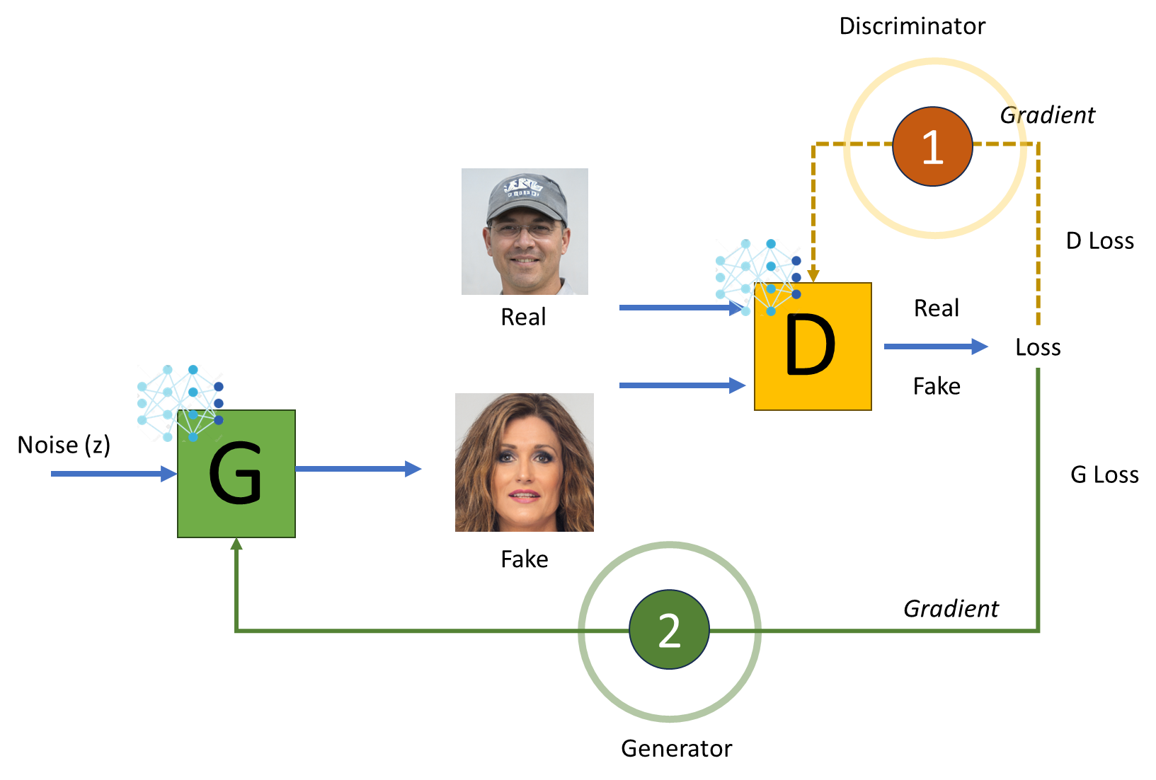
Phase One
Train the discriminator
Batch of real images is sampled from the training set and is completed with an equal number of fake images produced by the generator (labels are: 0=fake images, 1=real images)
The discriminator is trained on this labelled batch for one step, using the binary cross-entropy loss
Backpropagation only optimizes the weights of the discriminator during this phase

Slide 11
Phase Two
Train the generator
Produce a new batch of fake images, once again the discriminator says if the images are fake or real
This time we do not add real images in the batch (generator never actually sees any real images)
The weights of the discriminator are frozen during this step, so the backpropagation only affects the weights of the generator

Slide 12
Common Problems
Vanishing Gradients: when the discriminator doesn’t provide enough information for the generator to make progress (original GAN paper proposed a modification to the minmax loss to deal with vanishing gradient [2])
Mode Collapse: when the generator starts producing the same output (or a small set of outputs) over and over again. How can this happen? Suppose the generator gets better at producing convincing one type of result. It will fool the discriminator a bit more and will encourage it to produce more types of this image. Gradually it will forget how to produce anything else.
GANs sensitive to the hyperparameters: may need to spend a lot of effort fine-tuning them
[2] https://developers.google.com/machine-learning/gan/loss/

Slide 13
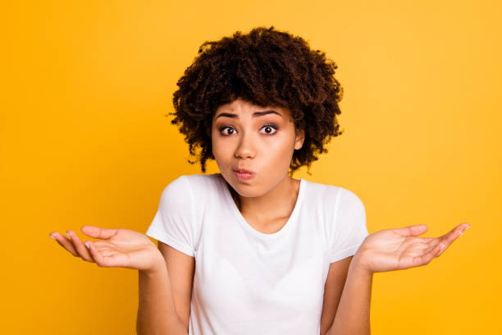
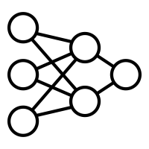
Neural Networks
How many neural networks (NN) does a GAN have?
What type of NN do net need to be?

Slide 14
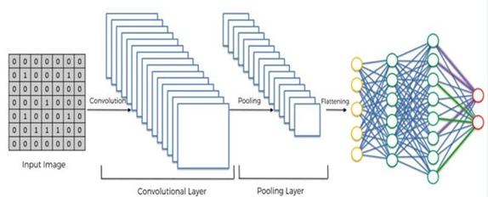
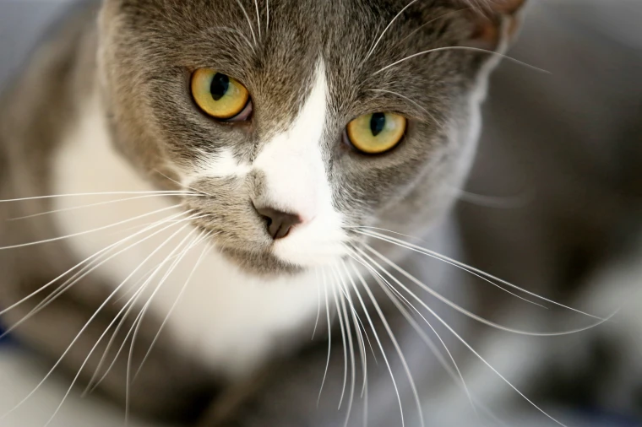
Neural Networks
GAN has two neural networks
What are the advantages of using CNN over the fully connected dense neural network?
Automatic feature extraction
Highly accurate at image recognition & classification
Weight sharing
Minimizes computation
Uses same knowledge across all image locations
Ability to handle large datasets
Hierarchical learning
Computationally faster

Slide 15
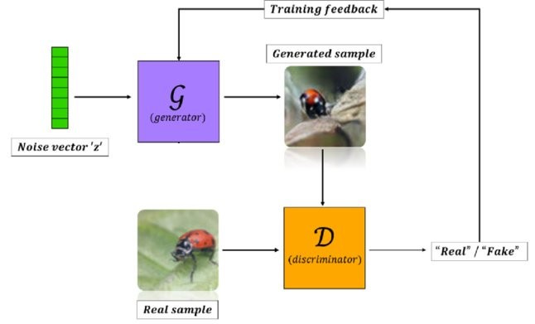
Deep Convolution GANs
Deep Convolutional GANs (DCGANs) 2015
Instead of ‘fully connected’ neural network –
change to Convolutional neural network (CNN)
Radford, Alec, Luke Metz, and Soumith Chintala. "Unsupervised representation learning with deep convolutional generative adversarial networks." arXiv preprint arXiv:1511.06434 (2015).

Slide 16
Deep Convolution GANs
Vanilla GAN to DCGAN
Outline of steps for building a stable Convolutional GAN
Replace any pooling layers with stridded convolutions (in the discriminator) and transpose convolutions (in the generator)
Use Batch Normalization in both the generator and the discriminator, except in the generator’s output layer and the discriminator’s input layer
Remove fully connected hidden layers for deep architectures
Use ReLU activation in the generator for all layers except the output layer, which should use tanh
Use leaky ReLU activation in the discriminator for all layers

Slide 17
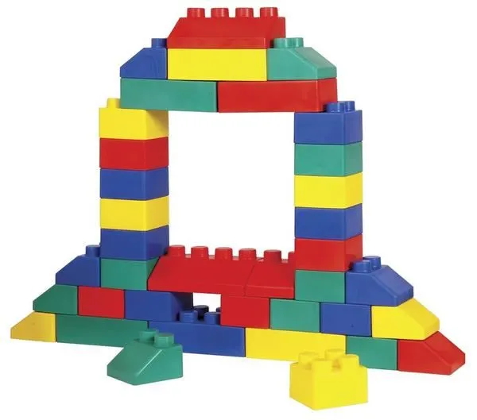
Let’s Build a DCGAN
Get some data (images)
Setup generator network
Test generator (noise)
Setup discriminator network
Link it together and train

Slide 18
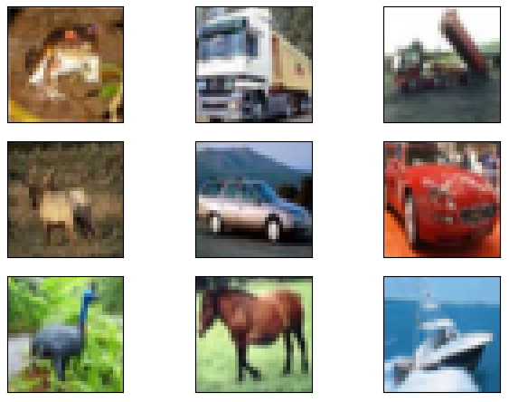
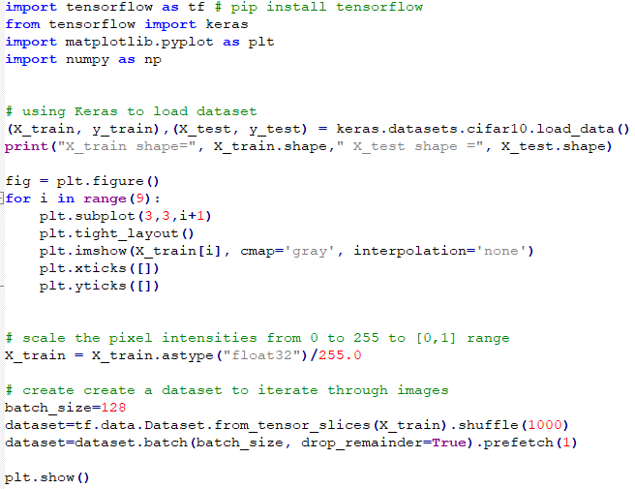
Example: Preparing Dataset cifar10
Code is available online test out example later:
https://f21dl.github.io/workshop/gans/

Slide 19
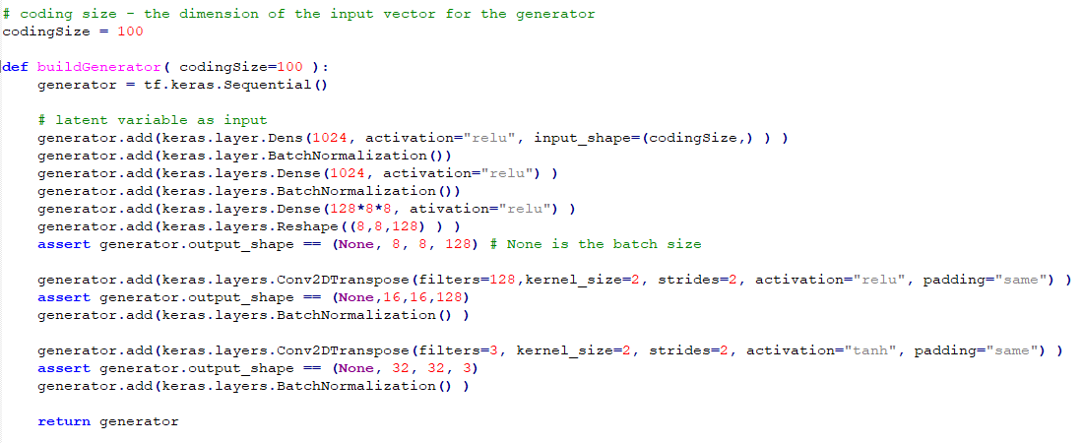
Example: The Generator

Slide 20
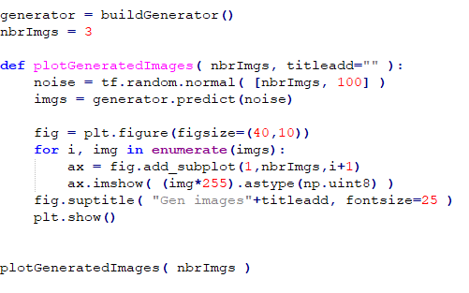
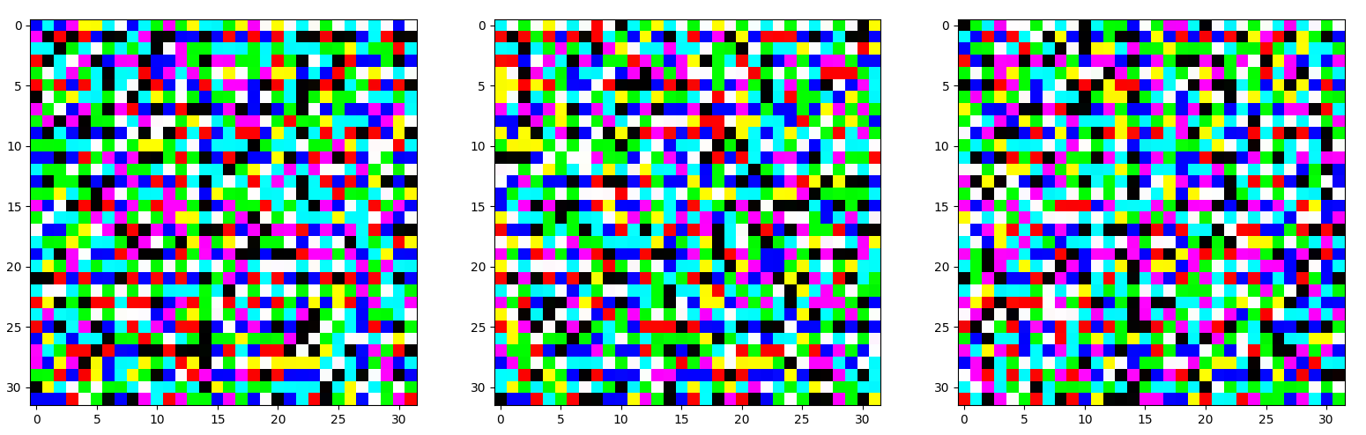
Example: The Generator (Plot)

Slide 21
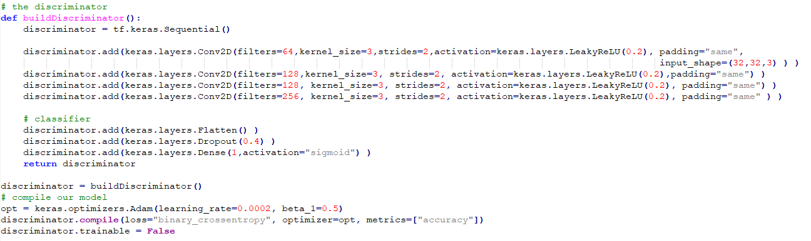
Example: The Discriminator

Slide 22
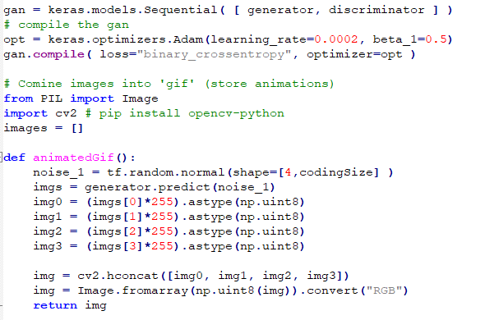
Example: Training the GAN

Slide 23
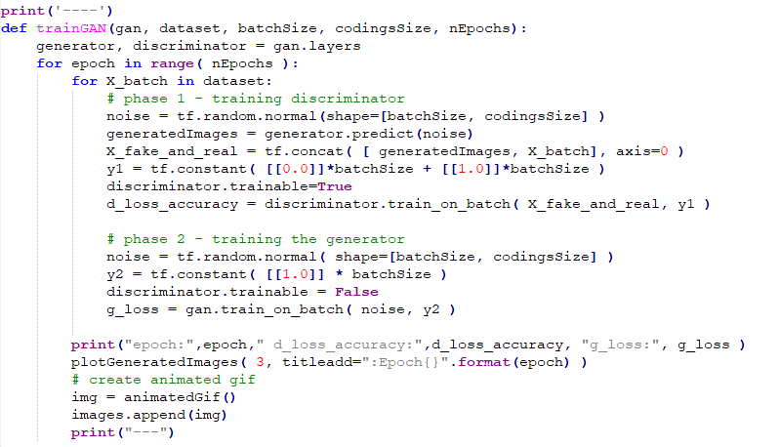
Example: Train the GAN (Loop)

Slide 24
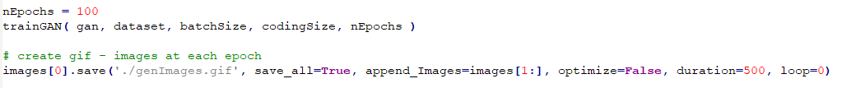
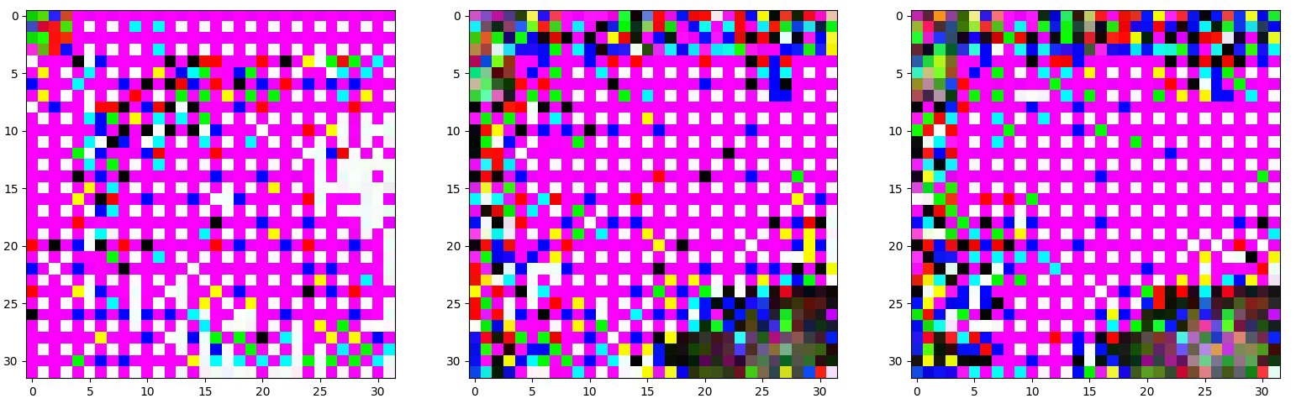
Example: Train the GAN (Result)
Epoch 1

Slide 25
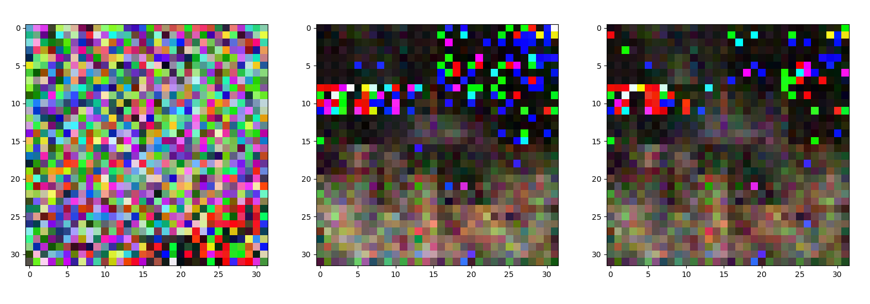
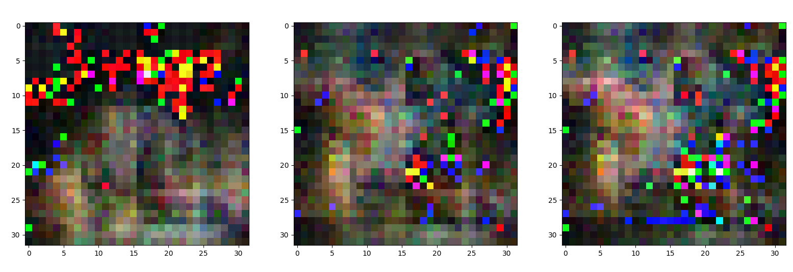
Epoch 4
Epoch 5

Slide 26
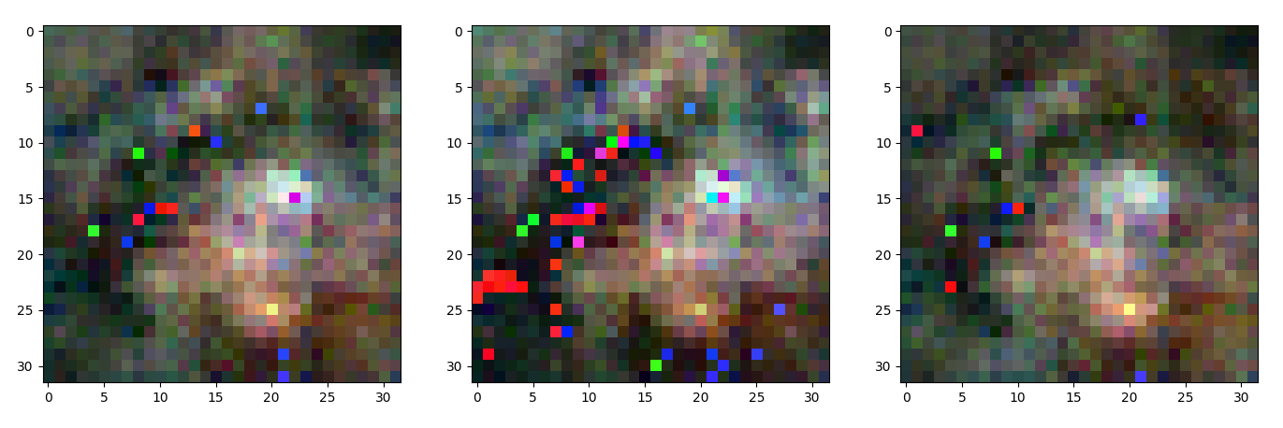
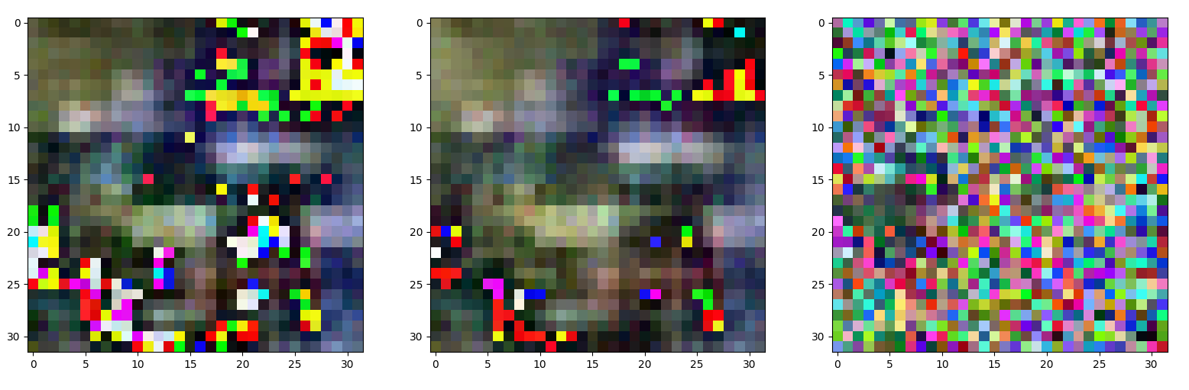
Epoch 6
Epoch 9

Slide 27
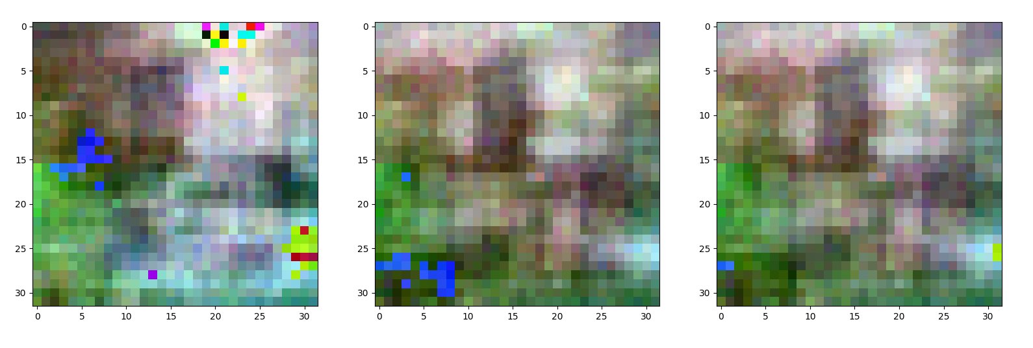
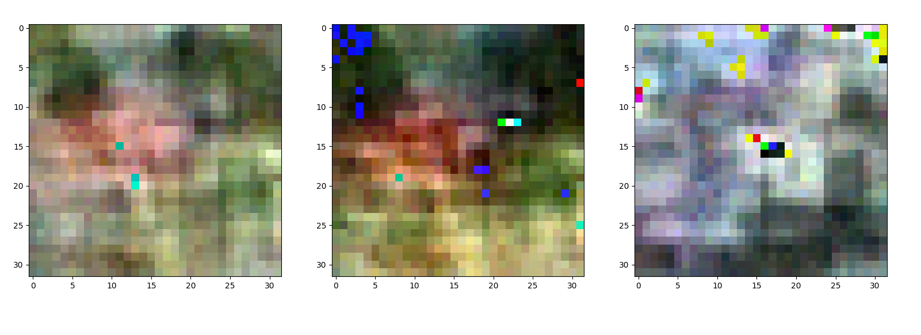
Epoch 12
Epoch 14

Slide 28
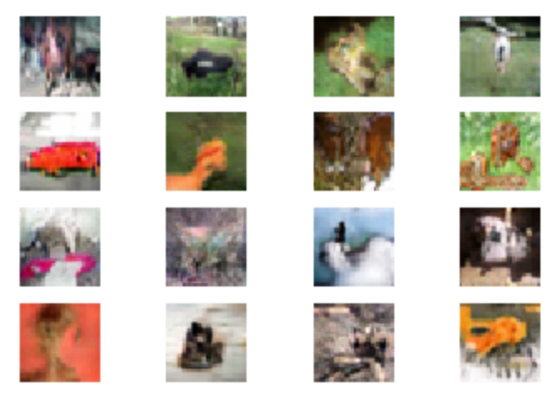

Works!!
As epochs increase, improves generated quality (also ‘test’)
Try today
more epochs (takes longer)
store/load trained network

Slide 29
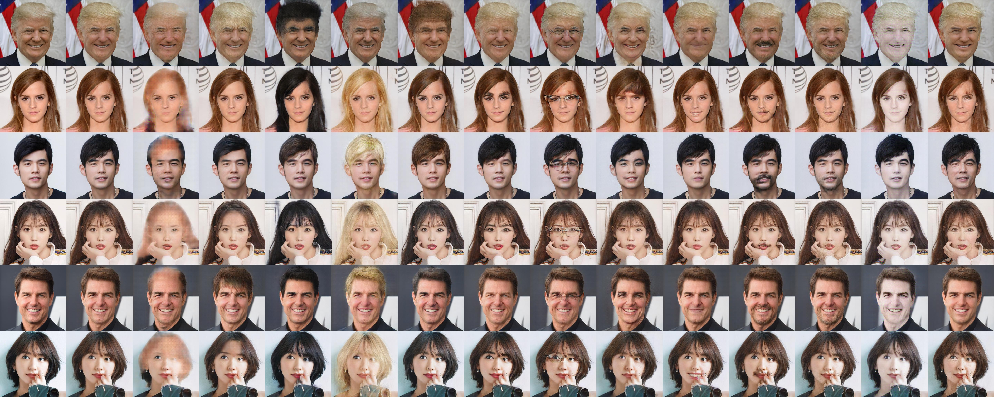
Example: AttGAN
AttGAN – Arbitrary Facial Attribute Editing (Only Change What You Want)
https://github.com/elvisyjlin/AttGAN-PyTorch
[Bald, Bangs, Black_Hair, Blond_Hair, Brown_Hair, Bushy_Eyebrows, Eyeglasses, Male, Mouth_Slightly_Open, Mustache, No_Beard, Pale_Skin]

Slide 30
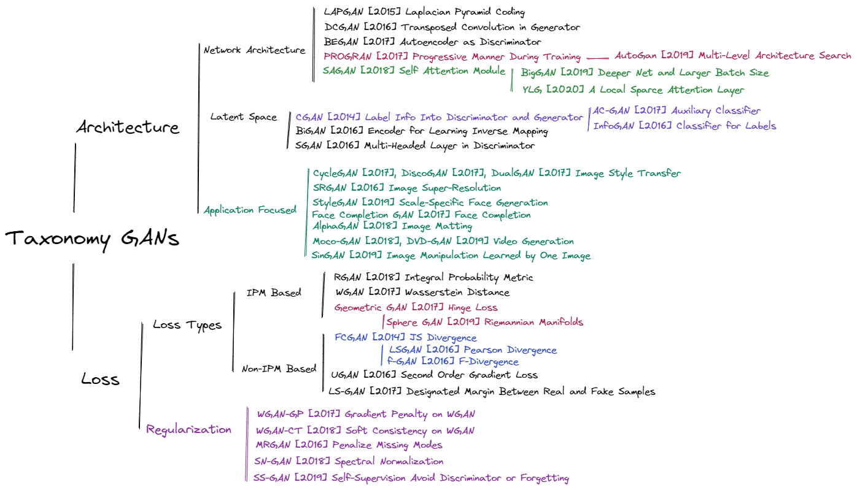
Recent GANs (Taxonomy)

Slide 31
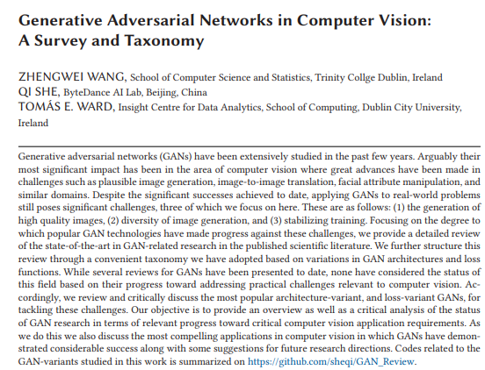
Recent GANs (Survey Paper)

Slide 32
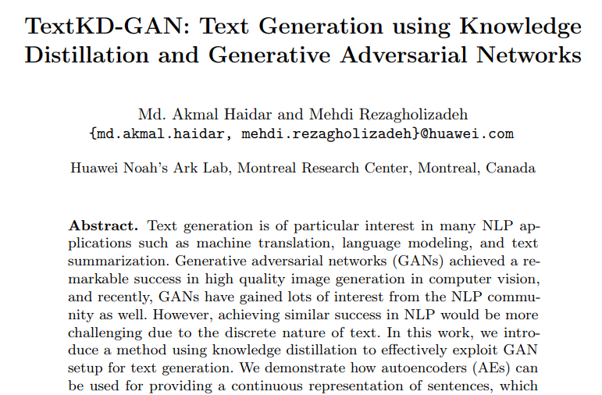
GANs in NLP
Article explores the use of a GAN for NLP tasks
(Proposes a GAN architecture)
https://arxiv.org/abs/1905.01976

Slide 33
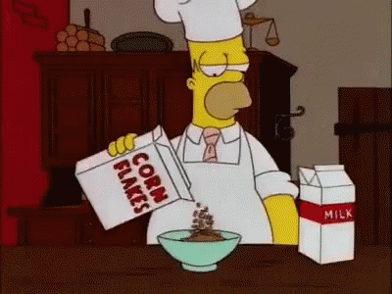
Thursday 19th October (Week 6) in LT1 at 9-10am and EM245 and EM252 10am-5pm.
Try Starter Code
https://f21dl.github.io/workshop/gans/
Experiment
Resources
GANS in Action
(https://www.manning.com/books/gans-in-action)
GANS Cookbook
https://github.com/PacktPublishing/Generative-Adversarial-Networks-Cookbook

Slide 34
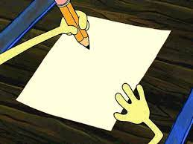
Create a GAN Concept Map
From your own memory, see if you can draw a concept map that visually represents the key components and concepts related to GANs. This helps them understand the structure of GANs and their various components.

Slide 35
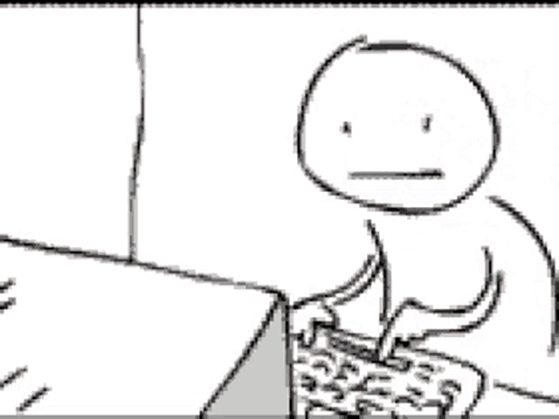
Coding a Simple GAN
Using the simple GAN code example discussed in the slides (i.e., DCGAN with cifar10 dataset) – after you’ve got it working on your own computer – change the dataset to another collection of images.
Remember, just to try out and have fun!!!
Don’t be stressed if it doesn’t work

Slide 36
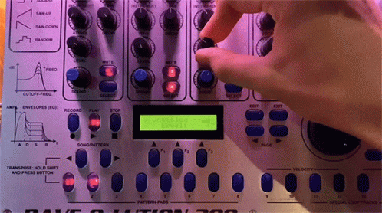
Tweaking GAN Parameters
Encourage you to modify the hyperparameters of a GAN model (e.g., learning rate, number of layers) to see how it affects the quality of generated images. This hands-on experience helps you understand the impact of different settings.

Slide 37
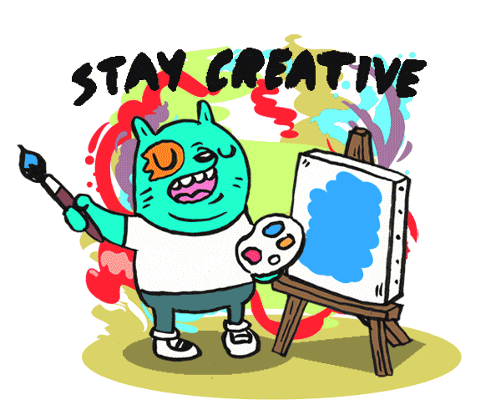
GAN Art: Create Your Own Artwork
Experiment using a GAN model to generate artwork. You can experiment with different input images or text prompts to see how the GAN interprets and generates art.

Slide 38
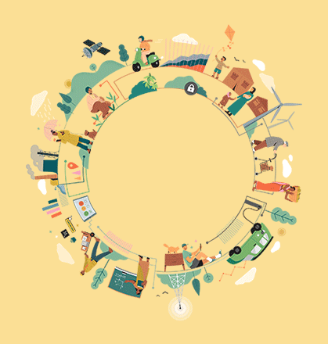
GANs in Other Fields
Discuss how GANs are used in fields like healthcare, finance, and cybersecurity. Explore real-world applications and case studies.

Slide 39
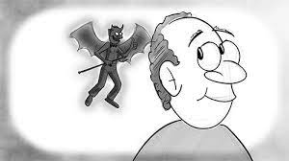
Discussion on Bias and Ethics
Discussion about the ethical considerations and biases that can arise in GAN-generated content (think about responsible AI use).

Slide 40
Questions
Starter Code
https://f21dl.github.io/workshop/gans/
Ideas
Cartoon dataset
Fonts/text
Frames from a film (e.g., convert the frames to single images)
Tuning/speed-ups (noise, ..)
Products/designs
Street maps
Game level designs
Instead of human faces focus on other objects, hands, feet, chairs, glasses, ..

